Slide 1
CSI4999 - Project 6
Rec Center Management
Sprint 3 Presentation
By: Eapen James, Noah Giles, Aaron Goodfellow, Tyler Streu, Taylor Piot, Doris Gjata, Eric Myllyoja

Slide 2
Sprint 3’s User Stories We focused on
As a user, I want to see occupied / reserved rooms through via a calendar
As a user, I want to see the home page and navigate easily around.
As a user, I want to see Membership information.
Notes:
Eapen

Slide 3
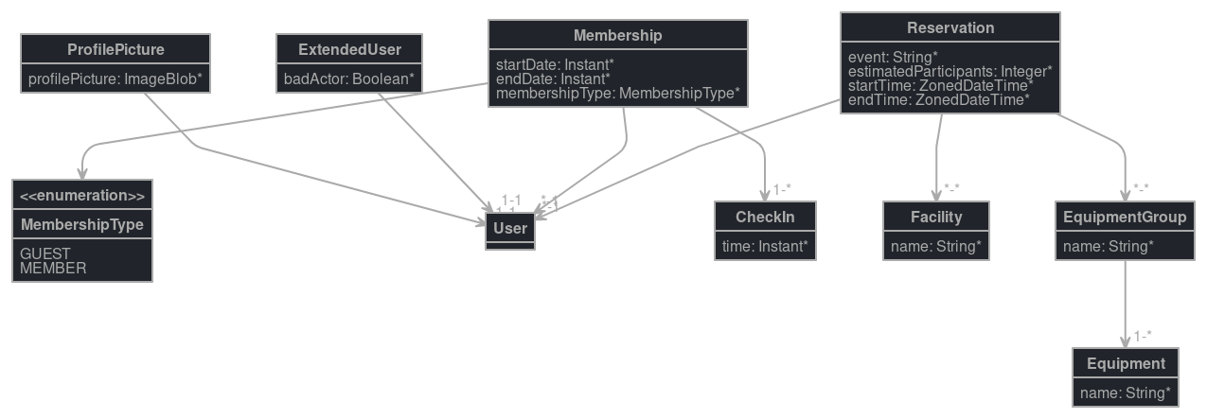
Entity Diagram
Notes:
Noah and Eric

Slide 4
QA Testing
User can view calendar
User can navigate through website pages
User can see Membership page
User is directed to Home page when they visit the Rec Center website
New Sign pages work and load correctly
Notes:
Eric

Slide 5
Risks and Challenges
Frontend and UI implementation
Some teammates are still learning React, but they can now plan and implement features, which they did in this sprint.
There is confusion on what the final UI should look like. Some teammates disagree on what features go where and how it will look like in context with the other UI components.
Difficulty designing and inserting a functional calendar (used for rentals) into the page.
Adding more pages that JHipster did not generate
Some pages (i.e. Membership Rates information) need to be manually added to JHipster. We solved it.
Team disagreements on planning and confusion on roles
MDBreact licensing cost and finding alternatives
MDBreact causing styling conflicts with JHipster’s initial UI framework reactstrap
Notes:
Doris
To be edited

Slide 6
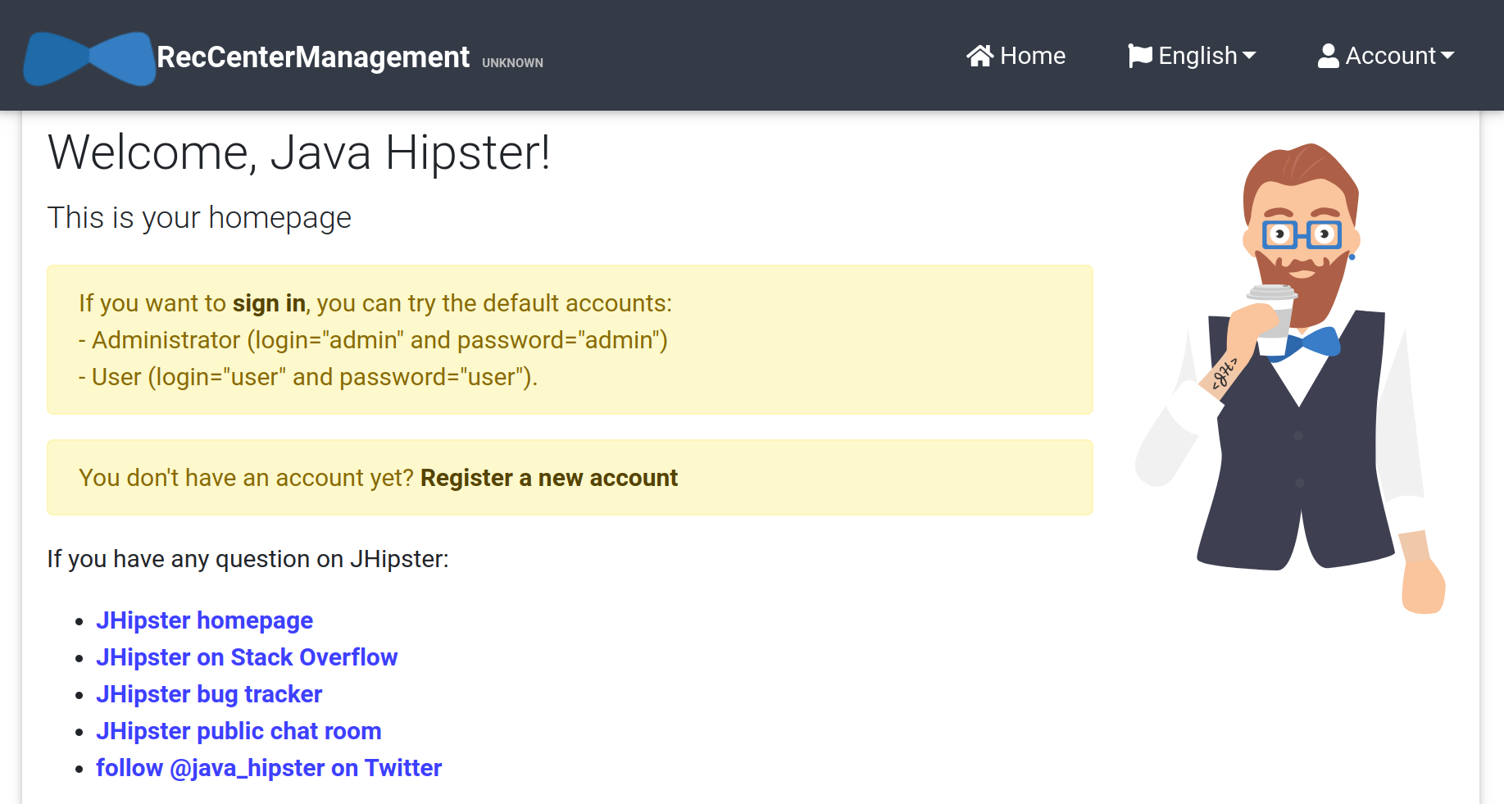
Notes:
Aaron

Slide 7
DEMO
Notes:
Aaron with anyone else chiming in about their future plans

Slide 8
Next Sprint Objectives
Stories:
1. As a user, I can reserve a room 2. As a user, I can see available equipment 3. As an administrator, I can assign equipment to a room
What that entails:
3. Populate DB with existing rooms 4. Equipment Entities 5. Talking about how equipment and rooms go together
Notes:
Tyler

